Slide 1
Recommender Systems
Lectured by Shangsong Liang
Sun Yat-sen University
Originally produced by Dietmar Jannach, Gerhard Friedrich

Slide 2


Slide 3

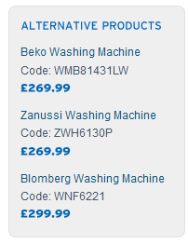
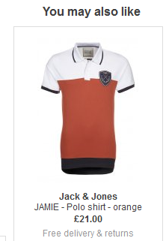
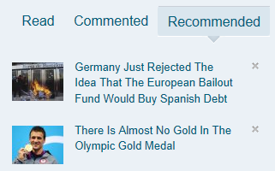
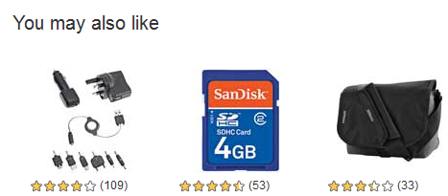
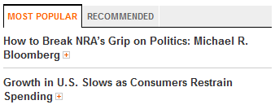
Recommender Systems
Application areas

Slide 4
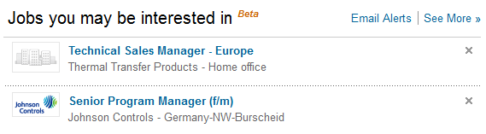
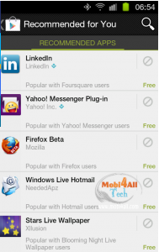
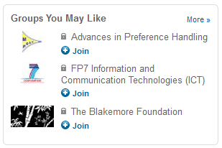
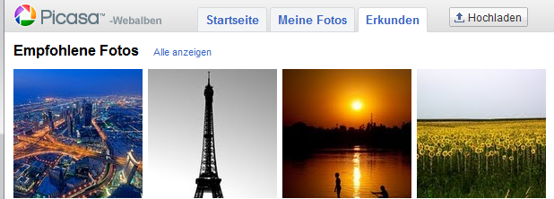
In the Social Web

Slide 5
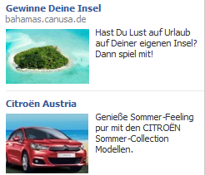
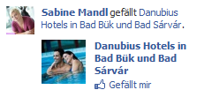
Even more …
Personalized search
"Computational advertising"

Slide 6
Agenda
What are recommender systems for?
  Introduction
How do they work (Part I) ?
  Collaborative Filtering
How to measure their success?
  Evaluation techniques
How do they work (Part II) ?
  Content-based Filtering
  Knowledge-Based Recommendations
  Hybridization Strategies
Advanced topics
  Explanations
  Human decision making

Slide 7

Introduction

Slide 8
Why using Recommender Systems?
Value for the customer
  Find things that are interesting
  Narrow down the set of choices
  Help me explore the space of options
  Discover new things
  Entertainment
  …
Value for the provider
  Additional and probably unique personalized service for the customer
  Increase trust and customer loyalty
  Increase sales, click trough rates, conversion etc.
  Opportunities for promotion, persuasion (劝说)
  Obtain more knowledge about customers
  …

Slide 9
Real-world check
Myths from industry
  Amazon.com generates X percent of their sales through the recommendation lists (30 < X < 70)
  Netflix (DVD rental and movie streaming) generates X percent of their sales through the recommendation lists (30 < X < 70)
There must be some value in it
  See recommendation of groups, jobs or people on LinkedIn
  Friend recommendation and ad personalization on Facebook
  Song recommendation at last.fm
  News recommendation at Forbes.com (plus 37% CTR (Click Through Rate))
Academia
  A few studies exist that show the effect
    increased sales, changes in sales behavior

Slide 10



Problem domain
Recommendation systems (RS) help to match users with items
  Ease information overload
  Sales assistance (guidance, advisory, persuasion(劝说),…)
  RS are software agents that elicit (诱发) the interests and preferences of individual consumers […] and make recommendations accordingly.
  They have the potential to support and improve the quality of the
  decisions consumers make while searching for and selecting products online.
                [Xiao & Benbasat, MISQ, 2007]
Different system designs / paradigms
  Based on availability of exploitable data
  Implicit and explicit user feedback
  Domain characteristics

Slide 11
Recommender systems
RS seen as a function [AT05]
Given:
  User model (e.g. ratings, preferences, demographics, situational context)
  Items (with or without description of item characteristics)
Find:
  Relevance score. Used for ranking.
Finally:
  Recommend items that are assumed to be relevant
But:
  Remember that relevance might be context-dependent
  Characteristics of the list itself might be important (diversity)

Slide 12
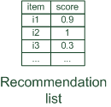

Paradigms of recommender systems
Recommender systems reduce information overload by estimating relevance

Slide 13


Paradigms of recommender systems
Personalized recommendations

Slide 14

Paradigms of recommender systems
Collaborative: "Tell me what's popular among my peers"

Slide 15

Paradigms of recommender systems
Content-based: "Show me more of the same what I've liked"

Slide 16


Paradigms of recommender systems
Knowledge-based: "Tell me what fits based on my needs"

Slide 17
Paradigms of recommender systems
Hybrid: combinations of various inputs and/or composition of different mechanism

Slide 18


Recommender systems: basic techniques
 | Pros | Cons
Collaborative | No knowledge-engineering effort, serendipity of results, learns market segments | Requires some form of rating feedback, cold start for new users and new items
Content-based | No community required, comparison between items possible | Content descriptions necessary, cold start for new users, no surprises
Knowledge-based | Deterministic recommendations, assured quality, no cold-start, can resemble sales dialogue | Knowledge engineering effort to bootstrap, basically static, does not react to short-term trends

Slide 19
Collaborative Filtering

Slide 20

Collaborative Filtering (CF)
The most prominent approach to generate recommendations
  used by large, commercial e-commerce sites
  well-understood, various algorithms and variations exist
  applicable in many domains (book, movies, DVDs, ..)
Approach
  use the "wisdom of the crowd" to recommend items
Basic assumption and idea
  Users give ratings to catalog items (implicitly or explicitly)
  Customers who had similar tastes in the past, will have similar tastes in the future

Slide 21
1992: Using collaborative filtering to weave an information tapestry, D. Goldberg et al., Communications of the ACM
Basic idea: "Eager readers read all docs immediately, casual readers wait for the eager readers to annotate"
Experimental mail system at Xerox Parc that records reactions of users when reading a mail
Users are provided with personalized mailing list filters instead of being forced to subscribe
  Content-based filters (topics, from/to/subject…)
  Collaborative filters
E.g. Mails to [all] which were replied by [John Doe] and which received positive ratings from [X] and [Y].

Slide 22
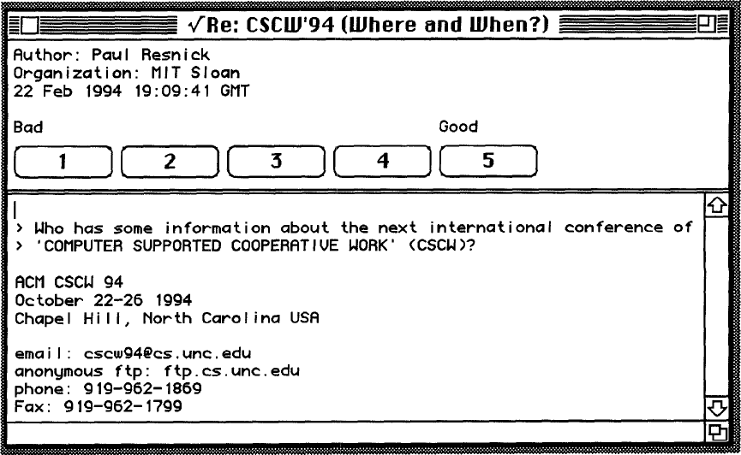
1994: GroupLens: an open architecture for collaborative filtering of netnews, P. Resnick et al., ACM CSCW
Tapestry system does not aggregate ratings and requires knowing each other
Basic idea: "People who agreed in their subjective evaluations in the past are likely to agree again in the future"
Builds on newsgroup browsers with rating functionality

Slide 23
User-based nearest-neighbor collaborative filtering (1)
The basic technique:
  Given an "active user" (Alice) and an item I not yet seen by Alice
  The goal is to estimate Alice's rating for this item, e.g., by
    find a set of users (peers) who liked the same items as Alice in the past and who have rated item I
    use, e.g. the average of their ratings to predict, if Alice will like item I
    do this for all items Alice has not seen and recommend the best-rated
 | Item1 | Item2 | Item3 | Item4 | Item5
Alice | 5 | 3 | 4 | 4 | ?
User1 | 3 | 1 | 2 | 3 | 3
User2 | 4 | 3 | 4 | 3 | 5
User3 | 3 | 3 | 1 | 5 | 4
User4 | 1 | 5 | 5 | 2 | 1

Slide 24

User-based nearest-neighbor collaborative filtering (2)
Some first questions
  How do we measure similarity?
  How many neighbors should we consider?
  How do we generate a prediction from the neighbors' ratings?
 | Item1 | Item2 | Item3 | Item4 | Item5
Alice | 5 | 3 | 4 | 4 | ?
User1 | 3 | 1 | 2 | 3 | 3
User2 | 4 | 3 | 4 | 3 | 5
User3 | 3 | 3 | 1 | 5 | 4
User4 | 1 | 5 | 5 | 2 | 1

Slide 25


Measuring user similarity
A popular similarity measure in user-based CF: Pearson correlation
  a, b : users
  r_{a,p} : rating of user a for item p
  P : set of items, rated both by a and b
  Possible similarity values between -1 and 1; = user's average ratings
$\overline{r_{a}}$, $\overline{r_{b}}$
 | Item1 | Item2 | Item3 | Item4 | Item5
Alice | 5 | 3 | 4 | 4 | ?
User1 | 3 | 1 | 2 | 3 | 3
User2 | 4 | 3 | 4 | 3 | 5
User3 | 3 | 3 | 1 | 5 | 4
User4 | 1 | 5 | 5 | 2 | 1
sim = 0,85
sim = 0,70
sim = -0,79

Slide 26
Pearson correlation
Takes differences in rating behavior into account
Works well in usual domains, compared with alternative measures
  such as cosine similarity

Slide 27
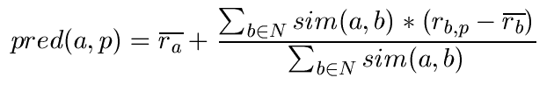

Making predictions
A common prediction function:
Calculate, whether the neighbors' ratings for the unseen item i are higher or lower than their average
Combine the rating differences – use the similarity as a weight
Add/subtract the neighbors' bias from the active user's average and use this as a prediction

Slide 28
Making recommendations
Making predictions is typically not the ultimate goal
Usual approach (in academia)
  Rank items based on their predicted ratings
However
  This might lead to the inclusion of (only) niche (特定的) items
  In practice also: Take item popularity into account
Approaches
  "Learning to rank"
    Optimize according to a given rank evaluation metric (see later)

Slide 29
Improving the metrics / prediction function
Not all neighbor ratings might be equally "valuable"
  Agreement on commonly liked items is not so informative as agreement on controversial (有争议的) items
  Possible solution: Give more weight to items that have a higher variance
Value of number of co-rated items
  Use "significance weighting", by e.g., linearly reducing the weight when the number of co-rated items is low
Case amplification
  Intuition: Give more weight to "very similar" neighbors, i.e., where the similarity value is close to 1.
Neighborhood selection
  Use similarity threshold or fixed number of neighbors

Slide 30
Memory-based and model-based approaches
User-based CF is said to be "memory-based"
  the rating matrix is directly used to find neighbors / make predictions
  does not scale for most real-world scenarios
  large e-commerce sites have tens of millions of customers and millions of items
Model-based approaches
  based on an offline pre-processing or "model-learning" phase
  at run-time, only the learned model is used to make predictions
  models are updated / re-trained periodically
  large variety of techniques used
  model-building and updating can be computationally expensive

Slide 31
2001: Item-based collaborative filtering recommendation algorithms, B.
Sarwar et al., WWW 2001
Scalability issues arise with U2U if many more users than items
(m >> n , m = |users|, n = |items|)
  e.g. Amazon.com
  Space complexity O(m²) when pre-computed
  Time complexity for computing Pearson O(m²n)
High sparsity leads to few common ratings between two users
Basic idea: "Item-based CF exploits relationships between items first, instead of relationships between users"

Slide 32
Item-based collaborative filtering
Basic idea:
  Use the similarity between items (and not users) to make predictions
Example:
  Look for items that are similar to Item5
  Take Alice's ratings for these items to predict the rating for Item5
 | Item1 | Item2 | Item3 | Item4 | Item5
Alice | 5 | 3 | 4 | 4 | ?
User1 | 3 | 1 | 2 | 3 | 3
User2 | 4 | 3 | 4 | 3 | 5
User3 | 3 | 3 | 1 | 5 | 4
User4 | 1 | 5 | 5 | 2 | 1

Slide 33


The cosine similarity measure
Produces better results in item-to-item filtering
  for some datasets, no consistent picture in literature
Ratings are seen as vector in n-dimensional space
Similarity is calculated based on the angle between the vectors
Adjusted cosine similarity
  take average user ratings into account, transform the original ratings
  U: set of users who have rated both items a and b

Slide 34
Pre-processing for item-based filtering
Item-based filtering does not solve the scalability problem itself
Pre-processing approach by Amazon.com (in 2003)
  Calculate all pair-wise item similarities in advance
  The neighborhood to be used at run-time is typically rather small, because only items are taken into account which the user has rated
  Item similarities are supposed to be more stable than user similarities
Memory requirements
  Up to N² pair-wise similarities to be memorized (N = number of items) in theory
  In practice, this is significantly lower (items with no co-ratings)
  Further reductions possible
    Minimum threshold for co-ratings (items, which are rated at least by n users)
    Limit the size of the neighborhood (might affect recommendation accuracy)

Slide 35
More on ratings
Pure CF-based systems only rely on the rating matrix
Explicit ratings
  Most commonly used (1 to 5, 1 to 7 Likert response scales)
  Research topics
    "Optimal" granularity of scale; indication that 10-point scale is better accepted in movie domain
    Multidimensional ratings (multiple ratings per movie)
  Challenge
    Users not always willing to rate many items; sparse rating matrices
    How to stimulate users to rate more items?
Implicit ratings
  clicks, page views, time spent on some page, demo downloads …
  Can be used in addition to explicit ones; question of correctness of interpretation

Slide 36
Data sparsity problems
Cold start problem
  How to recommend new items? What to recommend to new users?
Straightforward approaches
  Ask/force users to rate a set of items
  Use another method (e.g., content-based, demographic or simply non-personalized) in the initial phase
Alternatives
  Use better algorithms (beyond nearest-neighbor approaches)
  Example:
    In nearest-neighbor approaches, the set of sufficiently similar neighbors might be too small to make good predictions
    Assume "transitivity" of neighborhoods

Slide 37
Example algorithms for sparse datasets
Recursive CF
  Assume there is a very close neighbor n of u who however has not rated the target item i yet.
  Idea:
    Apply CF-method recursively and predict a rating for item i for the neighbor
    Use this predicted rating instead of the rating of a more distant direct neighbor
 | Item1 | Item2 | Item3 | Item4 | Item5
Alice | 5 | 3 | 4 | 4 | ?
User1 | 3 | 1 | 2 | 3 | ?
User2 | 4 | 3 | 4 | 3 | 5
User3 | 3 | 3 | 1 | 5 | 4
User4 | 1 | 5 | 5 | 2 | 1
sim = 0,85
Predict rating for
User1

Slide 38
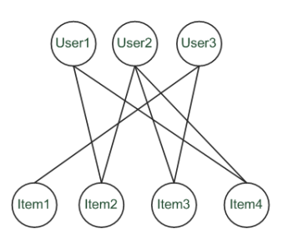
Graph-based methods
"Spreading activation" (sketch)
  Idea: Use paths of lengths > 3
  to recommend items
  Length 3: Recommend Item3 to User1
  Length 5: Item1 also recommendable

Slide 39
More model-based approaches
Plethora (大量) of different techniques proposed in the last years, e.g.,
  Matrix factorization techniques, statistics
    singular value decomposition, principal component analysis
  Association rule mining
    compare: shopping basket analysis
  Probabilistic models
    clustering models, Bayesian networks, probabilistic Latent Semantic Analysis
  Various other machine learning approaches
Costs of pre-processing
  Usually not discussed
  Incremental updates possible?

Slide 40
2000: Application of Dimensionality Reduction in
Recommender System, B. Sarwar et al., WebKDD Workshop
Basic idea: Trade more complex offline model building for faster online prediction generation
Singular Value Decomposition for dimensionality reduction of rating matrices
  Captures important factors/aspects and their weights in the data
  factors can be genre, actors but also non-understandable ones
  Assumption that k dimensions capture the signals and filter out noise (K = 20 to 100)
Constant time to make recommendations
Approach also popular in IR (Latent Semantic Indexing), data compression, …

Slide 41





A picture says …
Sue
Bob
Mary
Alice

Slide 42
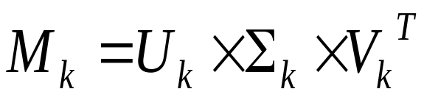


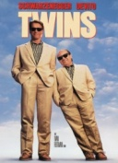


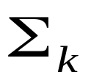
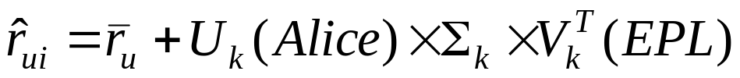
Matrix factorization
SVD:
U_{k} | Dim1 | Dim2
Alice | 0.47 | -0.30
Bob | -0.44 | 0.23
Mary | 0.70 | -0.06
Sue | 0.31 | 0.93
V_{k}^{T}
Dim1 | -0.44 | -0.57 | 0.06 | 0.38 | 0.57
Dim2 | 0.58 | -0.66 | 0.26 | 0.18 | -0.36
 | Dim1 | Dim2
Dim1 | 5.63 | 0
Dim2 | 0 | 3.23
Prediction:
      = 3 + 0.84 = 3.84

Slide 43
Association rule mining
Commonly used for shopping behavior analysis
  aims at detection of rules such as
  "If a customer purchases baby-food then he also buys diapers
  in 70% of the cases"
Association rule mining algorithms
  can detect rules of the form X => Y (e.g., baby-food => diapers) from a set of sales transactions D = {t₁, t₂, … t_{n}}
  measure of quality: support, confidence

Slide 44
Probabilistic methods
Basic idea (simplistic version for illustration):
  given the user/item rating matrix
  determine the probability that user Alice will like an item i
  base the recommendation on such these probabilities
Calculation of rating probabilities based on Bayes Theorem
  How probable is rating value "1" for Item5 given Alice's previous ratings?
  Corresponds to conditional probability P(Item5=1 | X), where
    X = Alice's previous ratings = (Item1 =1, Item2=3, Item3= … )
  Can be estimated based on Bayes' Theorem
Usually more sophisticated methods used
  Clustering
  pLSA …

Slide 45
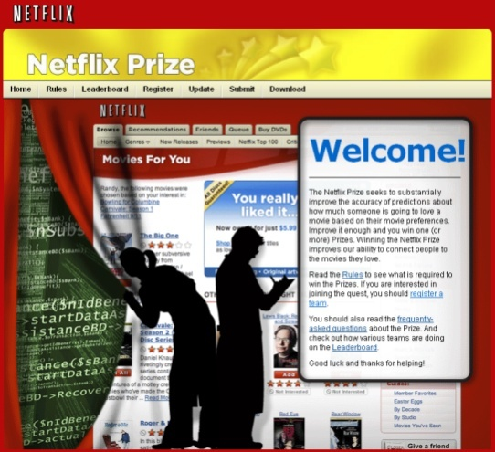
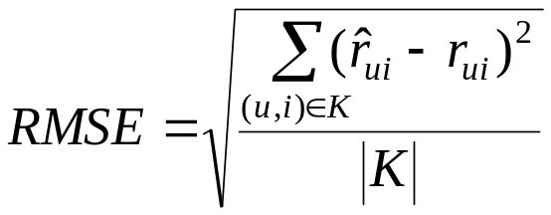
2008: Factorization meets the neighborhood: a multifaceted collaborative filtering model, Y. Koren, ACM SIGKDD
Stimulated by work on Netflix competition
  Prize of $1,000,000 for accuracy improvement of 10% RMSE compared to own Cinematch system
  Very large dataset (~100M ratings, ~480K users , ~18K movies)
  Last ratings/user withheld (set K)
Root mean squared error metric optimized to 0.8567

Slide 46

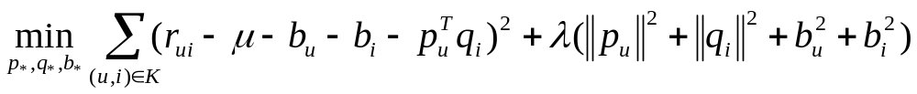
2008: Factorization meets the neighborhood: a multifaceted collaborative filtering model, Y. Koren, ACM SIGKDD
Merges neighborhood models with latent factor models
Latent factor models
  good to capture weak signals in the overall data
Neighborhood models
  good at detecting strong relationships between close items
Combination in one prediction single function
  Local search method such as stochastic gradient descent to determine parameters
  Add penalty for high values to avoid over-fitting

Slide 47

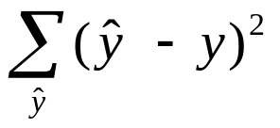
Summarizing recent methods
Recommendation is concerned with learning from noisy observations
(x, y), where
has to be determined such that
is minimal.
A variety of different learning strategies have been applied trying to estimate f(x)
  Non parametric neighborhood models
  MF models, SVMs, Neural Networks, Bayesian Networks,…

Slide 48
Collaborative Filtering Issues
Pros:
  well-understood, works well in some domains, no knowledge engineering required
Cons:
  requires user community, sparsity problems, no integration of other knowledge sources, no explanation of results
What is the best CF method?
  In which situation and which domain? Inconsistent findings; always the same domains and data sets; differences between methods are often very small (1/100)
How to evaluate the prediction quality?
  MAE / RMSE: What does an MAE of 0.7 actually mean?
  Serendipity: Not yet fully understood
What about multi-dimensional ratings?

Slide 49
Evaluation of Recommender Systems

Slide 50

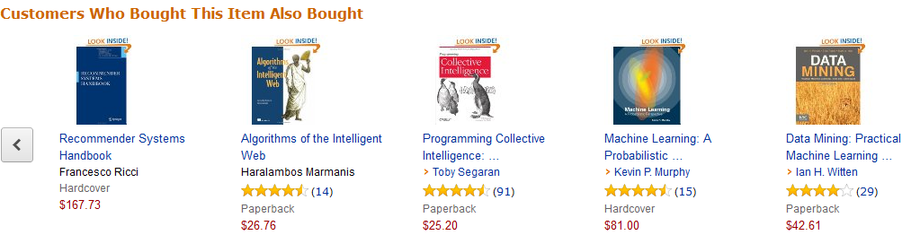
Recommender Systems in e-Commerce
One Recommender Systems research question
  What should be in that list?

Slide 51
Recommender Systems in e-Commerce
Another question both in research and practice
  How do we know that these are good recommendations?

Slide 52

Recommender Systems in e-Commerce
This might lead to …
  What is a good recommendation?
  What is a good recommendation strategy?
  What is a good recommendation strategy for my business?
We hope you will buy also …
These have been in stock for quite a while now …

Slide 53



What is a good recommendation?
  What are the measures in practice?
Total sales numbers
Promotion of certain items
…
Click-through-rates
Interactivity on platform
…
Customer return rates
Customer satisfaction and loyalty

Slide 54
Purpose and success criteria (1)
Different perspectives/aspects
  Depends on domain and purpose
  No holistic (整体的) evaluation scenario exists
Retrieval perspective
  Reduce search costs
  Provide "correct" proposals
  Assumption: Users know in advance what they want
Recommendation perspective
  Serendipity – identify items from the Long Tail
  Users did not know about existence
Notes:
Could a RS be a persuasive technology? In fact depending on the application area RS are deployed to:

Slide 55
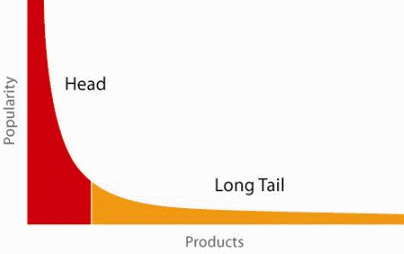
When does a RS do its job well?
"Recommend widely unknown items that users might actually like!"
20% of items accumulate 74% of all positive ratings
Recommend items
from the long tail

Slide 56
Purpose and success criteria (2)
Prediction perspective
  Predict to what degree users like an item
  Most popular evaluation scenario in research
Interaction perspective
  Give users a "good feeling"
  Educate users about the product domain
  Convince/persuade users - explain
Finally, conversion perspective
  Commercial situations
  Increase "hit", "clickthrough", "lookers to bookers" rates
  Optimize sales margins and profit

Slide 57




How do we as researchers know?
Test with real users
  A/B tests
  Example measures: sales increase, click through rates
Laboratory studies
  Controlled experiments
  Example measures: satisfaction with the system (questionnaires)
Offline experiments
  Based on historical data
  Example measures: prediction accuracy, coverage

Slide 58
Empirical research
Characterizing dimensions:
  Who is the subject that is in the focus of research?
  What research methods are applied?
  In which setting does the research take place?
Subject | Online customers, students, historical online sessions, computers, …
Research method | Experiments, quasi-experiments, non-experimental research
Setting | Lab, real-world scenarios

Slide 59
Research methods
Experimental vs. non-experimental (observational) research methods
  Experiment (test, trial):
    "An experiment is a study in which at least one variable is manipulated and units are randomly assigned to different levels or categories of manipulated variable(s)."
    Units: users, historic sessions, …
    Manipulated variable: type of RS, groups of recommended items,
    explanation strategies …
    Categories of manipulated variable(s): content-based RS, collaborative RS

Slide 60
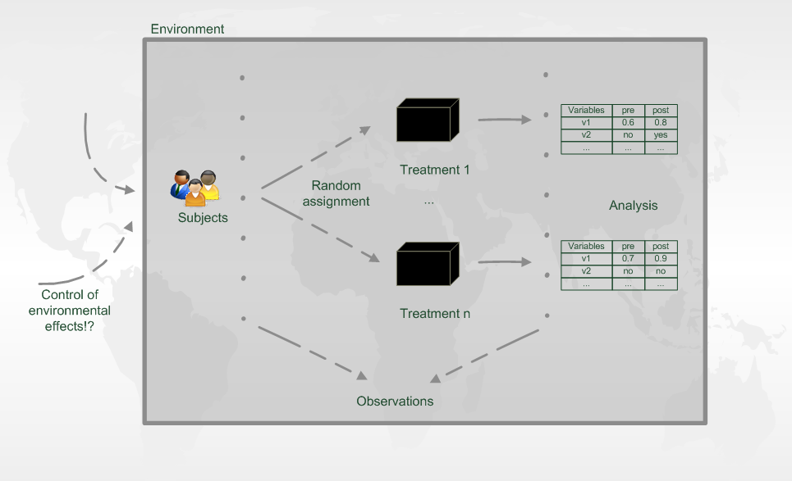
Experiment designs

Slide 61
Evaluation in information retrieval (IR)
Recommendation is viewed as information retrieval task:
  Retrieve (recommend) all items which are predicted to be "good" or "relevant".
Common protocol :
  Hide some items with known ground truth
  Rank items or predict ratings -> Count -> Cross-validate
Ground truth established by human domain experts
 |  | Reality
 |  | Actually Good | Actually Bad
Prediction | Rated Good | True Positive (tp) | False Positive (fp)
 | Rated Bad | False Negative (fn) | True Negative (tn)

Slide 62
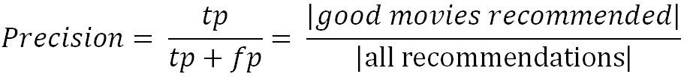
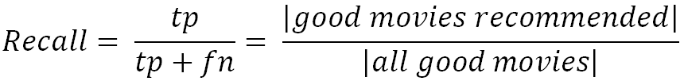
Metrics: Precision and Recall
Precision: a measure of exactness, determines the fraction of relevant items retrieved out of all items retrieved
  E.g. the proportion of recommended movies that are actually good
Recall: a measure of completeness, determines the fraction of relevant items retrieved out of all relevant items
  E.g. the proportion of all good movies recommended

Slide 63
Dilemma of IR measures in RS
IR measures are frequently applied, however:
  Ground truth for most items actually unknown
  What is a relevant item?
  Different ways of measuring precision possible
  Results from offline experimentation may have limited predictive power for
  online user behavior.

Slide 64
Metrics: Rank Score – position matters
For a user:
Actually good
Item 237
Item 899
Recommended (predicted as good)
Item 345
Item 237
Item 187
hit
Rank Score extends recall and precision to take the positions of correct items in a ranked list into account
  Particularly important in recommender systems as lower ranked items may be overlooked by users
  Learning-to-rank: Optimize models for such measures (e.g., AUC)

Slide 65

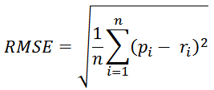
Accuracy measures
Datasets with items rated by users
  MovieLens datasets 100K-10M ratings
  Netflix 100M ratings
Historic user ratings constitute ground truth
Metrics measure error rate
  Mean Absolute Error (MAE) computes the deviation between predicted ratings and actual ratings
  Root Mean Square Error (RMSE) is similar to MAE, but places more emphasis on larger deviation

Slide 66
Offline experimentation example
Netflix competition
  Web-based movie rental
  Prize of $1,000,000 for accuracy improvement (RMSE) of 10% compared to own Cinematch system.
Historical dataset
  ~480K users rated ~18K movies on a scale of 1 to 5 (~100M ratings)
  Last 9 ratings/user withheld
    Probe set – for teams for evaluation
    Quiz set – evaluates teams’ submissions for leaderboard
    Test set – used by Netflix to determine winner
Today
  Rating prediction only seen as an additional input into the recommendation process

Slide 67
An imperfect world
Offline evaluation is the cheapest variant
  Still, gives us valuable insights
  and lets us compare our results (in theory)
Dangers and trends:
  Domination of accuracy measures
  Focus on small set of domains (40% on movies in CS)
Alternative and complementary measures:
  Diversity, Coverage, Novelty, Familiarity, Serendipity, Popularity, Concentration effects (Long tail)

Slide 68
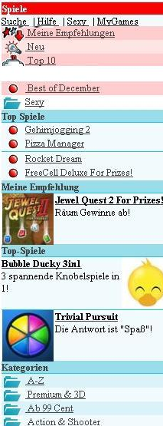
Online experimentation example
Effectiveness of different algorithms for recommending cell phone games
[Jannach, Hegelich 09]
Involved 150,000 users on a commercial mobile internet portal
Comparison of recommender methods

Slide 69
Details and results
Recommender variants included:
  Item-based collaborative filtering
  SlopeOne (also collaborative filtering)
  Content-based recommendation
  Hybrid recommendation
  Top-rated items
  Top-sellers
Findings:
  Personalized methods increased sales up to 3.6% compared to non-personalized
  Choice of recommendation algorithm depends on user situation
  (e.g. avoid content-based RS in post-sales situation)
} non-personalized

Slide 70
Non-experimental research
Quasi-experiments
  Lack random assignments of units to different treatments
Non-experimental / observational research
  Surveys / Questionnaires
  Longitudinal research
    Observations over long period of time
    E.g. customer life-time value, returning customers
  Case studies
  Focus group
    Interviews
    Think-aloud protocols

Slide 71
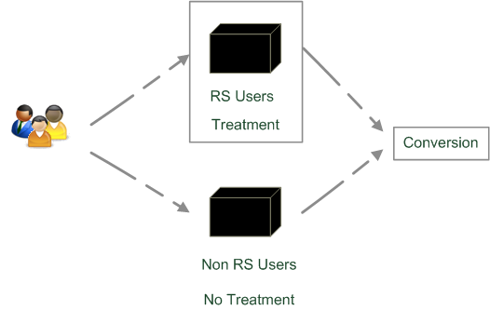
Quasi-experimental
SkiMatcher Resort Finder introduced by Ski-Europe.com to provide users with recommendations based on their preferences
Conversational RS
  question and answer dialog
  matching of user preferences with knowledge base
Delgado and Davidson evaluated the
effectiveness of the recommender over a
4 month period in 2001
  Classified as a quasi-experiment
  as users decide for themselves if they
  want to use the recommender or not

Slide 72
SkiMatcher Results
 | July | August | September | October
Unique Visitors | 10,714 | 15,560 | 18,317 | 24,416
SkiMatcher Users | 1,027 | 1,673 | 1,878 | 2,558
Non-SkiMatcher Users | 9,687 | 13,887 | 16,439 | 21,858
Requests for Proposals | 272 | 506 | 445 | 641
SkiMatcher Users | 75 | 143 | 161 | 229
Non-SkiMatcher Users | 197 | 363 | 284 | 412
Conversion | 2.54% | 3.25% | 2.43% | 2.63%
SkiMatcher Users | 7.30% | 8.55% | 8.57% | 8.95%
Non-SkiMatcher Users | 2.03% | 2.61% | 1.73% | 1.88%
Increase in Conversion | 359% | 327% | 496% | 475%
[Delgado and Davidson, ENTER 2002]

Slide 73
Interpreting the Results
The nature of this research design means that questions of causality cannot be answered (lack of random assignments), such as
  Are users of the recommender systems more likely convert?
  Does the recommender system itself cause users to convert?
  Some hidden exogenous variable might influence the choice of using RS as well as conversion.
However, significant correlation between using the recommender system and making a request for a proposal
Size of effect has been replicated in other domains
  Tourism [Jannach et al., JITT 2009]
  Electronic consumer products

Slide 74
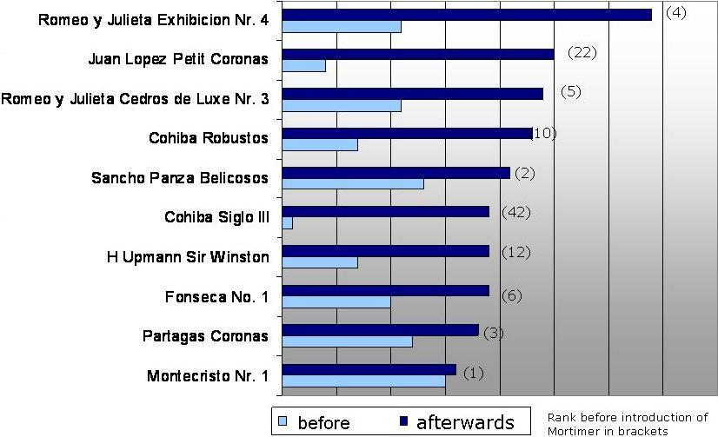
Observational research
Increased demand in niches/long tail products
  Ex-post from web shop data [Zanker et al., EC-Web, 2006]

Slide 75
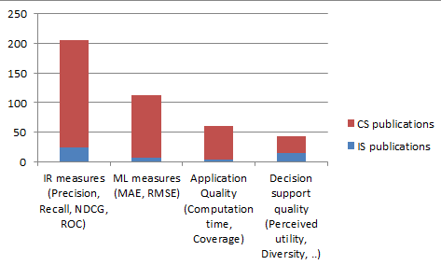
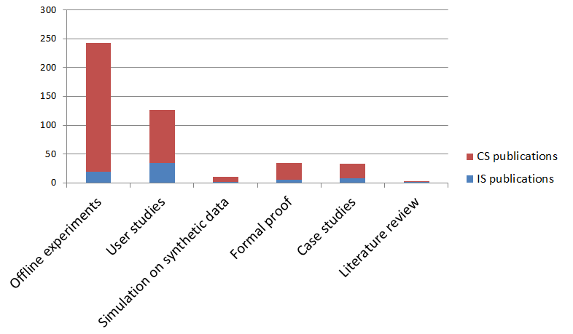
What is popular?
From: Jannach et al., Proceedings EC-Web 2012
User-centric evaluation / User studies
  Increased interest in recent years
  Various numbers of workshops

Slide 76
What are the next topics?
Two additional major paradigms of recommender systems
  Content-based
  Knowledge-based
Hybridization: take the best of different paradigms
Advanced topics: recommender systems are about human decision making

Slide 77
Content-based recommendation

Slide 78
Content-based recommendation
Collaborative filtering does NOT require any information about the items,
    However, it might be reasonable to exploit such information
    E.g. recommend fantasy novels to people who liked fantasy novels in the past
What do we need:
    Some information about the available items such as the genre ("content")
    Some sort of user profile describing what the user likes (the preferences)
The task:
    Learn user preferences
    Locate/recommend items that are "similar" to the user preferences

Slide 79
Paradigms of recommender systems
Content-based: "Show me more of the same what I've liked"

Slide 80
What is the "content"?
The genre is actually not part of the content of a book
Most CB-recommendation methods originate from Information Retrieval (IR) field:
  The item descriptions are usually automatically extracted (important words)
  Goal is to find and rank interesting text documents (news articles, web pages)
Here:
  Classical IR-based methods based on keywords
  No expert recommendation knowledge involved
  User profile (preferences) are rather learned than explicitly elicited

Slide 81
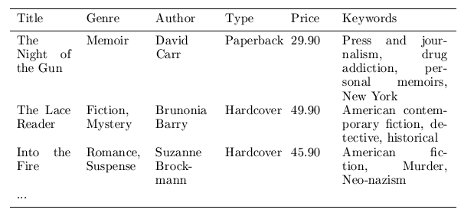
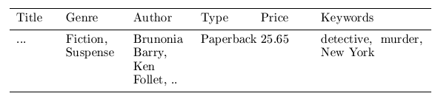
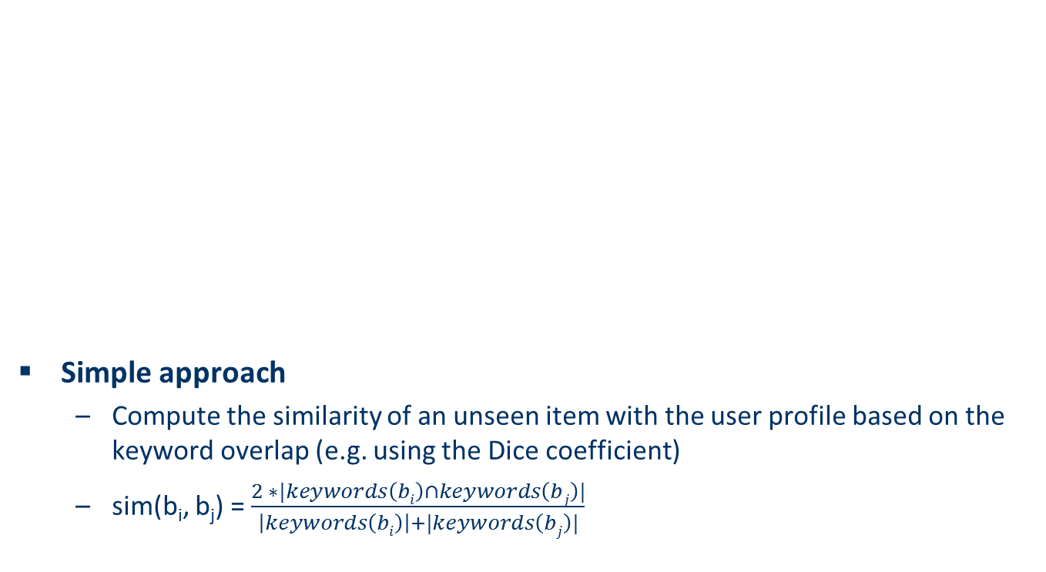
Content representation and item similarities
Simple approach
  Compute the similarity of an unseen item with the user profile based on the keyword overlap (e.g. using the Dice coefficient)
  sim(b_{i}, b_{j}) = $\frac{2 ∗|keywords\left(bi\right)∩keywords\left(bj\right)|}{\left|keywords\left(bi\right)\right|+|keywords\left(bj\right)|}$
Notes:
Intersection

Slide 82
Term-Frequency - Inverse Document Frequency (TF-IDF)
Simple keyword representation has its problems
  In particular when automatically extracted because
    Not every word has similar importance
    Longer documents have a higher chance to have an overlap with the user profile
Standard measure: TF-IDF
  Encodes text documents as weighted term vector
  TF: Measures, how often a term appears (density in a document)
    Assuming that important terms appear more often
    Normalization has to be done in order to take document length into account
  IDF: Aims to reduce the weight of terms that appear in all documents

Slide 83
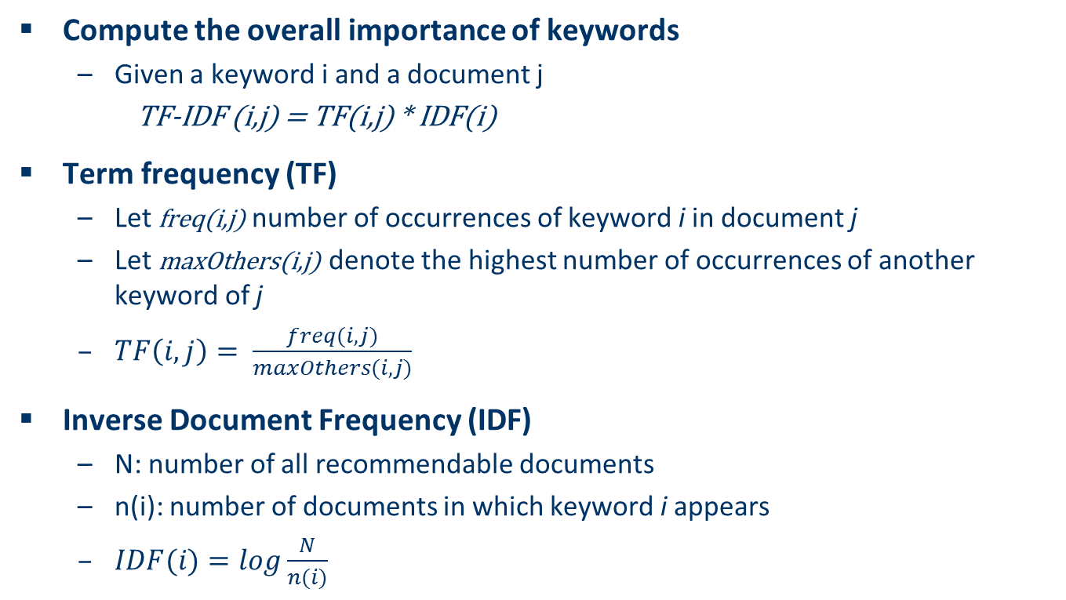
TF-IDF
Compute the overall importance of keywords
  Given a keyword i and a document j
  TF-IDF (i,j) = TF(i,j) * IDF(i)
Term frequency (TF)
  Let freq(i,j) number of occurrences of keyword i in document j
  Let maxOthers(i,j) denote the highest number of occurrences of another keyword of j
  $TF\left(i,j\right)= \frac{freq(i,j)}{maxOthers(i,j)}$
Inverse Document Frequency (IDF)
  N: number of all recommendable documents
  n(i): number of documents in which keyword i appears
  $IDF(i)=log\frac{N}{n(i)}$

Slide 84
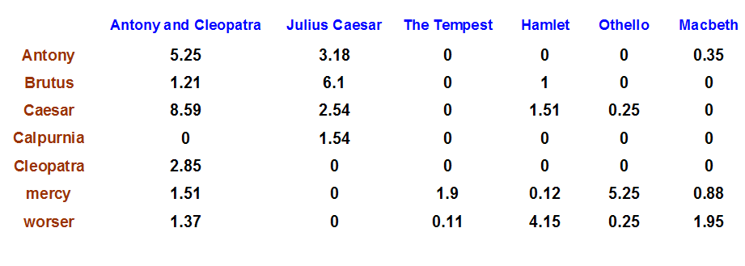
Example TF-IDF representation
Figure taken from http://informationretrieval.org

Slide 85
More on the vector space model
Vectors are usually long and sparse
Improvements
  Remove stop words ("a", "the", ..)
  Use stemming
  Size cut-offs (only use top n most representative words, e.g. around 100)
  Use additional knowledge, use more elaborate methods for feature selection
  Detection of phrases as terms (such as United Nations)
Limitations
  Semantic meaning remains unknown
  Example: usage of a word in a negative context
    "there is nothing on the menu that a vegetarian would like.."
Usual similarity metric to compare vectors: Cosine similarity (angle)

Slide 86
Recommending items
Simple method: nearest neighbors
  Given a set of documents D already rated by the user (like/dislike)
    Find the n nearest neighbors of a not-yet-seen item i in D
    Take these ratings to predict a rating/vote for i
    (Variations: neighborhood size, lower/upper similarity thresholds)
Query-based retrieval: Rocchio's method
  The SMART System: Users are allowed to rate (relevant/irrelevant) retrieved documents (feedback)
  The system then learns a prototype of relevant/irrelevant documents
  Queries are then automatically extended with additional terms/weight of relevant documents

Slide 87

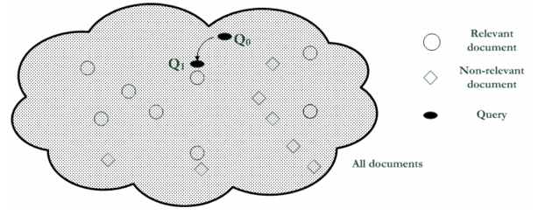
Rocchio details
Document collections D⁺ and D⁻
α, β, γ used to fine-tune
the feedback
often only positive feedback
is used

Slide 88
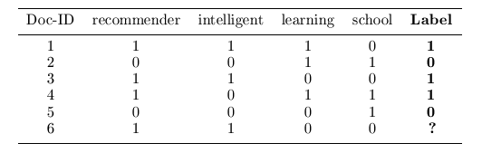
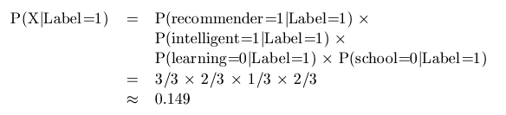
Probabilistic methods
Recommendation as classical text classification problem
  Long history of using probabilistic methods
Simple approach:
    2 classes: like/dislike
    Simple Boolean document representation
    Calculate probability that document is liked/disliked based on Bayes theorem
Remember:
P(Label=1|X)=
k*P(X|Label=1) * P(Label=1)

Slide 89
Improvements
Side note: Conditional independence of events does in fact not hold
  “New”/ “York“ and “Hong” / “Kong"
  Still, good accuracy can be achieved
Boolean representation simplistic
  Keyword counts lost
More elaborate probabilistic methods
  E.g. estimate probability of term v occurring in a document of class C by relative frequency of v in all documents of the class
Other linear classification algorithms (machine learning) can be used
  Support Vector Machines, ..

Slide 90
Limitations of content-based recommendation methods
Keywords alone may not be sufficient to judge quality/relevance of a document or web page
    Up-to-dateness, usability, aesthetics, writing style
    Content may also be limited / too short
    Content may not be automatically extractable (multimedia)
Ramp-up phase required
    Some training data is still required
    Web 2.0: Use other sources to learn the user preferences
Overspecialization
    Algorithms tend to propose "more of the same"
    E.g. too similar news items

Slide 91

Knowledge-Based Recommender Systems

Slide 92


Why do we need knowledge-based recommendation?
Products with low number of available ratings
Time span plays an important role
  Five-year-old ratings for computers
  User lifestyle or family situation changes
Customers want to define their requirements explicitly
  “The color of the car should be black"

Slide 93
Knowledge-based recommendation
Knowledge-based: "Tell me what fits based on my needs"

Slide 94
Knowledge-based recommendation I
Explicit domain knowledge
  Sales knowledge elicitation from domain experts
  System mimics the behavior of experienced sales assistant
  Best-practice sales interactions
  Can guarantee “correct” recommendations (determinism) with respect to expert knowledge
Conversational interaction strategy
  Opposed to one-shot interaction
  Elicitation of user requirements
  Transfer of product knowledge (“educating users”)

Slide 95
Knowledge-Based Recommendation II
Different views on “knowledge”
  Similarity functions
    Determine matching degree between query and item (case-based RS)
  Utility-based RS
    E.g. MAUT – Multi-attribute utility theory
  Logic-based knowledge descriptions (from domain expert)
    E.g. Hard and soft constraints

Slide 96


Constraint-based recommendation I
A knowledge-based RS formulated as constraint satisfaction problem
Def.
  X_{I}, X_{U}: Variables describing items and user model with domain D
  (e.g. lower focal length, purpose)
  KB: Knowledge base comprising constraints and domain restrictions
  (e.g. IF purpose=“on travel” THEN lower focal length < 28mm)
  SRS: Specific requirements of a user (e.g. purpose = “on travel”)
  I: Product catalog (e.g. (id=1 ˄ lfl = 28mm) ˅ (id=2 ˄ lfl= 35mm) ˅ …)
Solution: Assignment tuple assigning values to all variables X_{I}
is satisfiable.

Slide 97
Item ranking
Multi-Attribute Utility Theory (MAUT)
  Each item is evaluated according to a predefined set of dimensions that provide an aggregated view on the basic item properties
E.g. quality and economy are dimensions in the domain of digital cameras
id | value | quality | economy
price | ≤250 >250 | 5 10 | 10 5
mpix | ≤8 >8 | 4 10 | 10 6
opt-zoom | ≤9 >9 | 6 10 | 9 6
... | ... | ... | ...

Slide 98
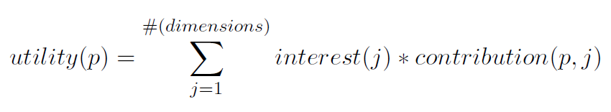
Customer-specific item utilities with MAUT
Customer interests:
Item utilities:
customer | quality | economy
Cu₁ | 80% | 20%
Cu₂ | 40% | 60%
*
quality | economy | utility: cu₁ | utility: cu₂
P1 Σ(5,4,6,6,3,7,10) = 41 | Σ (10,10,9,10,10,10,6) = 65 | 45.8 [8] | 55.4 [6]
P2 Σ(5,4,6,6,10,10,8) = 49 | Σ (10,10,9,10,7,8,10) = 64 | 52.0 [7] | 58.0 [1]
P3 Σ(5,4,10,6,10,10,8) = 53 | Σ (10,10,6,10,7,8,10) = 61 | 54.6 [5] | 57.8 [2]
... | ... | ... | ...
**
*
**

Slide 99




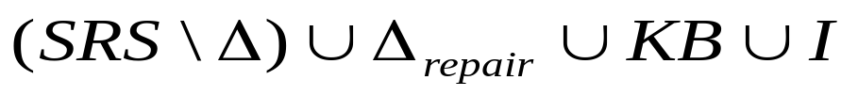

Constraint-based recommendation II
BUT: What if no solution exists?
  not satisfiable → debugging of knowledge base
  not satisfiable but
  correct → debugging of user requirements
Application of model-based diagnosis for debugging user requirements
  Diagnoses: is satisfiable
  Repairs: is satisfiable
  Conflict sets: not satisfiable

Slide 100

Example: find minimal relaxations (minimal diagnoses)
Knowledge Base:
Product catalogue:
 | LHS | RHS
C1 | TRUE | Brand = Brand pref.
C2 | Motives = Landscape | Low. foc. Length =< 28
C3 | TRUE | Price =< Max. cost
Powershot XY
Brand | Canon
Lower focal length | 35
Upper focal length | 140
Price | 420 EUR
Current user:
 | User model (SRS)
R1 | Motives | Landscape
R2 | Brand preference | Canon
R3 | Max. cost | 350 EUR
Lumix
Brand | Panasonic
Lower focal length | 28
Upper focal length | 112
Price | 319 EUR
CS1
CS2
Diagnoses:

Slide 101
Ask user
Computation of minimal revisions of requirements
  Do you want to relax your brand preference?
    Accept Panasonic instead of Canon brand
  Or is photographing landscapes with a wide-angle lens and maximum cost less important?
    Lower focal length > 28mm and Price > 350 EUR
  Optionally guided by some predefined weights or past community behavior
Be aware of possible revisions (e.g. age, family status, …)

Slide 102
Constraint-based recommendation III
More variants of recommendation task
  Customers maybe not know what they are seeking
  Find "diverse" sets of items
    Notion of similarity/dissimilarity
    Idea that users navigate a product space
    If recommendations are more diverse than users can navigate via critiques on recommended "entry points" more efficiently (less steps of interaction)
  Bundling of recommendations
    Find item bundles that match together according to some knowledge
      E.g. travel packages, skin care treatments or financial portfolios
      RS for different item categories, CSP restricts configuring of bundles

Slide 103
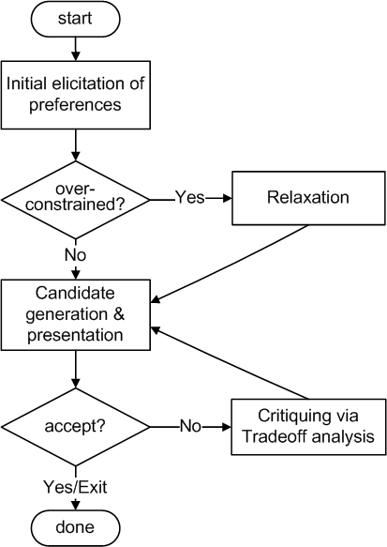
Conversational strategies
Process consisting of multiple conversational moves
  Resembles natural sales interactions
  Not all user requirements known beforehand
  Customers are rarely satisfied with the initial recommendations
Different styles of preference elicitation:
  Free text query interface
  Asking technical/generic properties
  Images / inspiration
  Proposing and Critiquing

Slide 104
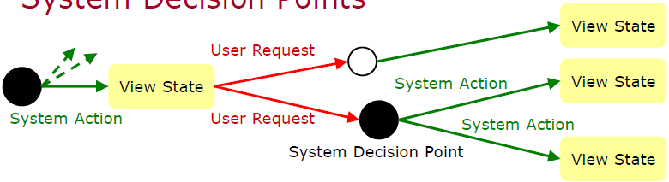
Example: adaptive strategy selection
State model, different actions possible
  Propose item, ask user, relax/tighten result set,…
[Ricci et al., JITT, 2009]

Slide 105
Limitations of knowledge-based recommendation methods
Cost of knowledge acquisition
  From domain experts
  From users
  Remedy: exploit web resources
Accuracy of preference models
  Very fine granular preference models require many interaction cycles with the user or sufficient detailed data about the user
  Remedy: use collaborative filtering, estimates the preference of a user
However: preference models may be instable
    E.g. asymmetric dominance effects and decoy items

Slide 106

Hybridization Strategies

Slide 107
Hybrid recommender systems
All three base techniques are naturally incorporated by a good sales assistance (at different stages of the sales act) but have their shortcomings
Idea of crossing two (or more) species/implementations
  hybrida [lat.]: denotes an object made by combining two different elements
  Avoid some of the shortcomings
  Reach desirable properties not present in individual approaches
Different hybridization designs
  Monolithic exploiting different features
  Parallel use of several systems
  Pipelined invocation of different systems

Slide 108
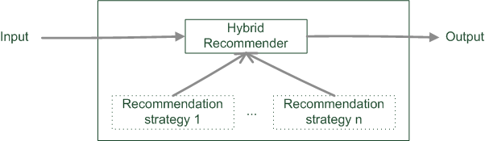
Monolithic hybridization design
Only a single recommendation component
Hybridization is "virtual" in the sense that
  Features/knowledge sources of different paradigms are combined

Slide 109
Monolithic hybridization designs: Feature combination
"Hybrid" user features:
  Social features: Movies liked by user
  Content features: Comedies liked by user, dramas liked by user
  Hybrid features: users who like many movies that are comedies, …
  “the common knowledge engineering effort that involves inventing good features to enable successful learning” [BHC98]

Slide 110
Monolithic hybridization designs: Feature augmentation
Content-boosted collaborative filtering [MMN02]
  Based on content features additional ratings are created
  E.g. Alice likes Items 1 and 3 (unary ratings)
    Item7 is similar to 1 and 3 by a degree of 0,75
    Thus Alice likes Item7 by 0,75
  Item matrices become less sparse
Recommendation of research papers [TMA+04]
  Citations interpreted as collaborative recommendations
  Integrated in content-based recommendation method

Slide 111
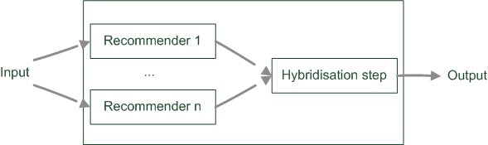
Parallelized hybridization design
Output of several existing implementations combined
Least invasive design
Weighting or voting scheme applied
  Weights can be learned dynamically

Slide 112

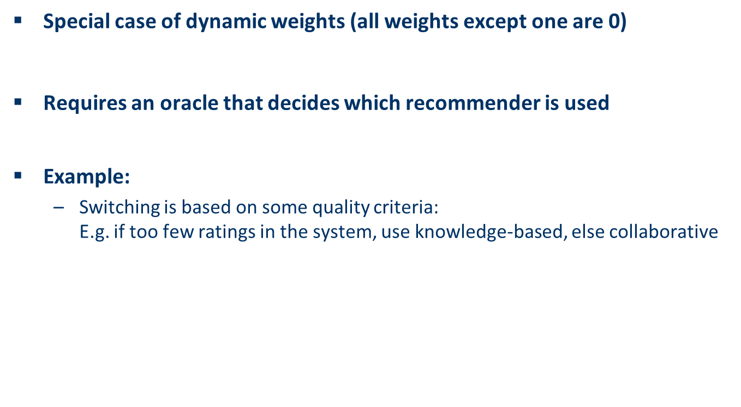
Parallelized hybridization design: Switching
Special case of dynamic weights (all weights except one are 0)
Requires an oracle that decides which recommender is used
Example:
  Switching is based on some quality criteria:
  E.g. if too few ratings in the system, use knowledge-based, else collaborative

Slide 113
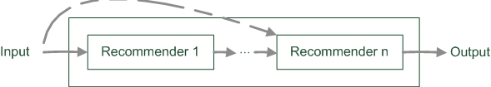
Pipelined hybridization designs
One recommender system pre-processes some input for the subsequent one
  Cascade
  Meta-level
Refinement of recommendation lists (cascade)
Learning of model (e.g. collaborative knowledge-based meta-level)

Slide 114



Pipelined hybridization designs: Cascade
Recommendation list is continually reduced
First recommender excludes items
  Remove absolute no-go items (e.g. knowledge-based)
Second recommender assigns score
  Ordering and refinement (e.g. collaborative)

Slide 115


Pipelined hybridization designs: Meta-level
Successor exploits a model $Δ$built by predecessor
$Δ_{{rec}_{n−1}}$is model built by RS_{n-1} exploited by RS_{n}
Examples:
  Fab system: content-based, collaborative recommendation [BS97]
    Online news domain
    Contend based recommender builds user models based on weighted term vectors
    Collaborative filtering identifies similar peers based on weighted term vectors but makes recommendations based on ratings
  Collaborative, constraint-based meta-level RS
    Collaborative filtering identifies similar peers
    A constraint base is learned by exploiting the behavior of similar peers
    Learned constraints are employed to compute recommendations

Slide 116
What is the best hybridization strategy?
Only few works that compare strategies from the meta-perspective
  For instance, [Burke02]
  Most datasets do not allow to compare different recommendation paradigms
    I.e. ratings, requirements, item features, domain knowledge, critiques rarely available in a single dataset
  Some conclusions are supported by empirical findings
    Monolithic: preprocessing effort traded-in for more knowledge included
    Parallel: requires careful design of scores from different predictors
    Pipelined: works well for two antithetic approaches
Netflix competition – “stacking” recommender systems
  Weighted design based on >100 predictors – recommendation functions
  Adaptive switching of weights based on user model, parameters

Slide 117

Advanced topics I
Explanations in recommender systems

Slide 118
Explanations in recommender systems
Motivation
  “The digital camera Profishot is a must-buy for you because . . . .”
  Why should recommender systems deal with explanations at all?
  The answer is related to the two parties providing and receiving recommendations:
    A selling agent may be interested in promoting particular products
    A buying agent is concerned about making the right buying decision

Slide 119

Explanations in recommender systems
Additional information to explain the system’s output following some objectives

Slide 120
Objectives of explanations
Transparency
Validity
Trustworthiness
Persuasiveness
Effectiveness
Efficiency
Satisfaction
Relevance
Comprehensibility
Education

Slide 121



Explanations in general
How? and Why? explanations in expert systems
Form of abductive reasoning
  Given: ${KB\text{⊨}}_{RS}i$ (item i is recommended by method RS)
  Find $KB^{′}⊆KB$s.t. ${KB^{′}\text{⊨}}_{RS}i$
Principle of succinctness
  Find smallest subset of $KB^{′}⊆KB$s.t. ${KB^{′}\text{⊨}}_{RS}i$
    i.e. for all $KB′′⊂KB^{′}$holds${{ KB}^{′′}\text{⊭} }_{RS}i$
But additional filtering
  Some parts relevant for
  deduction, might be obvious
  for humans
[Friedrich & Zanker, AI Magazine, 2011]

Slide 122

Taxonomy for generating explanations in RS
Major design dimensions of current explanation components:
Category of reasoning model for generating explanations
  White box
  Black box
RS paradigm for generating explanations
  Determines the exploitable semantic relations
Information categories

Slide 123

RS paradigms and their ontologies
Classes of objects
  Users
  Items
  Properties
N-ary relations between them
Collaborative filtering
  Neighborhood based CF (a)
  Matrix factorization (b)
    Introduces additional factors as proxies for determining similarities

Slide 124
RS paradigms and their ontologies
Content-based
  Properties characterizing items
  TF*IDF model
Knowledge based
  Properties of items
  Properties of user model
  Additional mediating domain concepts

Slide 125



Similarity between items
Similarity between users
Tags
  Tag relevance (for item)
  Tag preference (of user)

Slide 126


Thermencheck.com (hot spring resorts)
It offers services for families with small children, such as X, Y and Z.
It is a spa resort of medium size offering around 1000 beds.
The water has favorable properties for X, but it is unknown if it also cures Y.
It offers organic food, but no kosher food.

Slide 127
Results from testing the explanation feature
+**
Positive
Usage exp.
Perceived
Utility
+**
+*
Recommend others
+**
Explanation
+
Intention to repeated usage
+**
Trust
** sign. < 1%, * sign. < 5%
Knowledgeable explanations significantly increase the users’ perceived utility
Perceived utility strongly correlates with usage intention etc.

Slide 128
Explanations in recommender systems: Summary
There are many types of explanations and various goals that an explanation can achieve
Which type of explanation can be generated depends greatly on the recommender approach applied
Explanations may be used to shape the wishes and desires of customers but are a double-edged sword
  On the one hand, explanations can help the customer to make wise buying decisions;
  On the other hand, explanations can be abused to push a customer in a direction which is advantageous solely for the seller
As a result a deep understanding of explanations and their effects on customers is of great interest.

Slide 129

Advanced topics II
Online consumer decision making
RS are about Human decision making

Slide 130
Reality check regarding F₁ and accuracy measures for RS
Real value for companies lies in increasing conversions
  ... and satisfaction with bought items, low churn rate
Some reasons why it might be a fallacy to think F₁ on historical data is a good estimate for real conversion:
  Recommendation can be self-fulfilling prophecy
    Users’ preferences are not invariant, but can be constructed [ALP03]
  Position/Rank is what counts (e.g. serial position effects)
    Actual choices are heavily biased by the item’s position [FFG+07]
  Inclusion of weak (dominated) items increases users’ confidence
    Replacing some recommended items by decoy items fosters choice towards the remaining options [TF09]
  …

Slide 131
Consequently
The understanding of online users' purchasing behavior is of high importance for companies
This purchasing behavior can be explained by different models of human decision making

Slide 132
Effort of decision versus accuracy
Model focuses on cost-benefit aspects
  People attempt to make accurate choices
  People want to minimize effort
Some methods for making choices are highly accurate
  They involve considering a lot of information
  Calculating expected utility is a high-accurate and high-effort way of making a choice
Some methods are simpler
  They involve considering less information
  Also called heuristics

Slide 133
Examples of decision heuristics
Simplification is an underlying concept of heuristics
Satisficing
  Choose the first item that is satisfactory
Elimination by Aspects
  Start with the most important attribute
  Eliminate all item that are not satisfactory
  Proceed with the next most important attribute
  Come up with evolved set
Reason-based choice
  People want to be able to justify their choices
  May make decisions that are easiest to justify

Slide 134

Some decision phenomena due to heuristics
Phenomenon/Effect | Description
Decoy effects | Additional irrelevant (inferior) items in an item set significantly influence the selection behavior
Primacy/recency effects | Items at the beginning and the end of a list are analyzed significantly more often/deeply than items in the middle of a list
Framing effects | The way in which different decision alternatives are presented influences the final decision taken
Priming | If specific decision properties are made more available in memory, this influences a consumer's item evaluations (background priming)
Defaults | Preset options bias the decision process

Slide 135
Decoy: asymmetric dominance effect
Product A dominates D in both dimensions (price and download limit)
Product B dominates alternative D in only one dimension (price)
The additional inclusion of D into the choice set could trigger an increase of the selection probability of A
Product | A | B | D
price per month | 30 | 20 | 50
download limit | 10GB | 6GB | 9GB

Slide 136



Example impact of decoy effect

Slide 137
Personality
Different personality properties pose specific requirements on the design of recommender user interfaces
Some personality traits are more susceptible to heuristical simplifications
Provide various interfaces

Slide 138
Personality traits
Theory | Description
Internal vs. external Locus of control (LOC) | Externally influenced users need more guidance; internally controlled users want to actively and selectively search for additional information
Need for closure | Describes the individual pursuit of making a decision as soon as possible
Maximizer vs. satisficer | Maximizers try to find an optimal solution; satisficers search for solutions that fulfill their basic requirements

Slide 139
Summary of online consumer decision making
Recommender systems are persuasive systems
Estimated-utility is often not a good model of human decision making
Several simplifying heuristics
Bounded rationality / accuracy-effort-tradeoff makes users susceptible for decision biases
Decoy effects, position effects, framing, priming, defaults,…
Different personality characteristics require different recommender interaction methods (Max/sat., need4closure, trust, locOfcontrol)

Slide 140
Outlook
Additional topics covered by the book “Recommender Systems - An Introduction”
  Case study on the Mobile Internet
  Attacks on CF Recommender Systems
  Recommender Systems in the next generation Web (Social Web, Semantic Web)
  More on consumer decision making
  Recommending in ubiquitous environments
Current and emerging topics in RS
  Social Web recommendations
  Context-aware recommendation
  Learning-to-rank

Slide 141
References
[Adomavicius & Tuzhilin, IEEE TKDE, 2005] Adomavicius G., Tuzhilin, A. Toward the next generation of recommender systems: a survey of the state-of-the-art and possible extensions, IEEE TKDE, 17(6), 2005, pp.734-749.
[ALP03] Ariely, D., Loewenstein, G., Prelec, D. (2003) “Coherent Arbitrainess”: Stable Demand Curves Without Stable Preferences. The Quarterly Journal of Economics, February 2003, 73-105.
[BKW+10] Bollen, D., Knijnenburg, B., Willemsen, M., Graus, M. (2010) Understanding Choice Overload in Recommender Systems. ACM Recommender Systems, 63-70.
[Brynjolfsson et al., Mgt. Science, 2003] Brynjolfsson, E., Hu, Y., Smith, M.: Consumer Surplus in the Digital Economy: Estimating the Value of Increased Product Variety at Online Booksellers, Management Science, Vol 49(11), 2003, pp. 1580-1596.
[BS97] Balabanovic, M., Shoham, Y. (1997) Fab: content-based, collaborative recommendation, Communications of the ACM, Vol. 40(3), pp. 66-72.
[FFG+07] Felfernig, A. , Friedrich, G., Gula, B. et al. (2007) Persuasive recommendation: serial position effects in knowledge-based recommender systems. 2nd international conference on Persuasive technology, Springer, 283–294.
[Friedrich& Zanker, AIMag, 2011] Friedrich, G., Zanker, M.: A Taxonomy for Generating Explanations in Recommender Systems. AI Magazine, Vol. 32(3), 2011.
[Jannach et al., CUP, 2010] Jannach D., Zanker M., Felfernig, A., Friedrich, G.: Recommender Systems an Introduction, Cambridge University Press, 2010.
[Jannach et al., JITT, 2009] Jannach, D., Zanker, M., Fuchs, M.: Constraint-based recommendation in tourism: A multi-perspective case study, Information Technology & Tourism, Vol 11(2), pp. 139-156.
[Jannach, Hegelich 09] Jannach, D., Hegelich K.: A case study on the effectiveness of recommendations in the Mobile Internet, ACM Conference on Recommender Systems, New York, 2009, pp. 205-208
[Ricci et al., JITT, 2009] Mahmood, T., Ricci, F., Venturini, A.: Improving Recommendation Effectiveness by Adapting the Dialogue Strategy in Online Travel Planning. Information Technology & Tourism, Vol 11(4), 2009, pp. 285-302.
[Teppan& Felfernig, CEC, 2009] Teppan, E., Felfernig, A.: Asymmetric Dominance- and Compromise Effects in the Financial Services Domain. IEEE International Conference on E-Commerce and Enterprise Computing, 2009, pp. 57-64
[TF09] Teppan, E., Felfernig, A. (2009) Impacts of decoy elements on result set evaluations in knowledge-based recommendation. Int. J. Adv. Intell. Paradigms 1, 358–373.

Slide 142
References
[Xiao & Benbasat, MISQ, 2007] Xiao, B., Benbasat, I.: E-Commerce Product Recommendation Agents: Use, Characteristics, and Impact, MIS Quarterly, Vol 31(1), pp. 137-209.
[Zanker et al., EC-Web, 2006] Zanker, M., Bricman, M., Gordea, S., Jannach, D., Jessenitschnig, M.: Persuasive online-selling in quality & taste domains, 7th International Conference on Electronic Commerce and Web Technologies, 2006, pp. 51-60.
[Zanker, RecSys, 2008] Zanker M., A Collaborative Constraint-Based Meta-Level Recommender. ACM Conference on Recommender Systems, 2008, pp. 139-146.
[Zanker et al., UMUAI, 2009] Zanker, M., Jessenitschnig, M., Case-studies on exploiting explicit customer requirements in recommender systems, User Modeling and User-Adapted Interaction, Springer, 2009, pp.133-166.
[Zanker et al., JITT, 2009] Zanker M., Jessenitschnig M., Fuchs, M.: Automated Semantic Annotations of Tourism Resources Based on Geospatial Data, Information Technology & Tourism, Vol 11(4), 2009, pp. 341-354.
[Zanker et al., Constraints, 2010] Zanker M., Jessenitschnig M., Schmid W.: Preference reasoning with soft constraints in constraint-based recommender systems. Constraints, Springer, Vol 15(4), 2010, pp. 574-595.

